Slide 1


SMART INDIA HACKATHON 2024
Problem Statement ID –1593
Problem Statement Title- Student Innovation
Theme - Robotics and Drones
PS Category- Software
Team ID-
Team Name - HACTIVATORS

Slide 2
Team Member Details
HACTIVATORS
TEAM DESCRIPTION
Team Member 1 Name: Akhil S
Branch : B.Tech
Team Member 2 Name: Ganesh Sarathi Sivaswamy
Stream : CSE
Year : I
Branch : B.Tech
Team Member 3 Name: Somesh Bharathwaj K
Branch : B.Tech
Team Member 4 Name: Chittesh D P
Branch : B.Tech
Team Member 5 Name: Dayanitha B
Branch : B.Tech
Team Member 6 Name: Punita Hari
Branch : B.Tech
Team Mentor Name: K. Abirami
Category : Academic
Stream : CSE
Year : I
Stream : CSE
Year : I
Stream : CSE
Year : I
Stream : CSE
Year : I
Stream : CSE
Year : I
Expertise: Networks and cloud computing
Domain Experience (in years):

Slide 3
Drone-Powered Search and Rescue in Disaster Zones
HACTIVATORS
IDEA / SOLUTION :
Drones are capable of surveying broad regions rapidly, detecting victims using ai algorithms.
Integrating software with drones to enable autonomous navigation, real-time data analysis, and coordinated search and rescue operations in disaster zones.
Essential information for making decisions is provided by high-resolution cameras and sensors such as GPR, ThermalScanners,etc..
Drones can provide vital supplies and direct rescue crews to victims during search and rescue operations by sending the coordinates to the software.
By evaluating structural damage and spotting possible threats, drones can help with stabilization measures.
Problem Resolution :
Utilizing drones with ai human detection algorithm for search, rescue, and stabilization improves response time, provides real-time data, accesses hazardous areas, and delivers medical supplies efficiently, reducing human risk.
Unique Value Propositions (UVP) :
In order to expedite search and rescue efforts, using this software with drones provide quick deployment.
Use AI to analyze drone footage for rapid identification of victims, hazards, and potential access points.
They improve coordination and situational awareness by offering real-time aerial data.
Connect drone software with existing emergency response systems for seamless coordination.

Slide 4
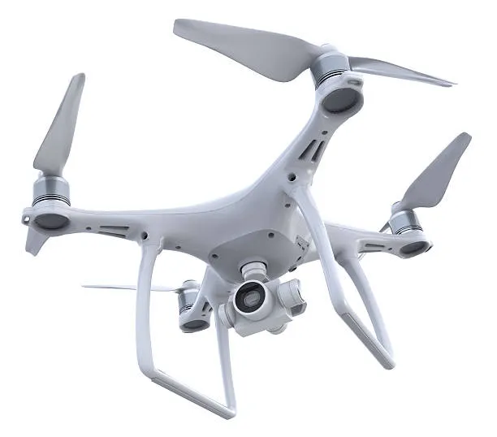
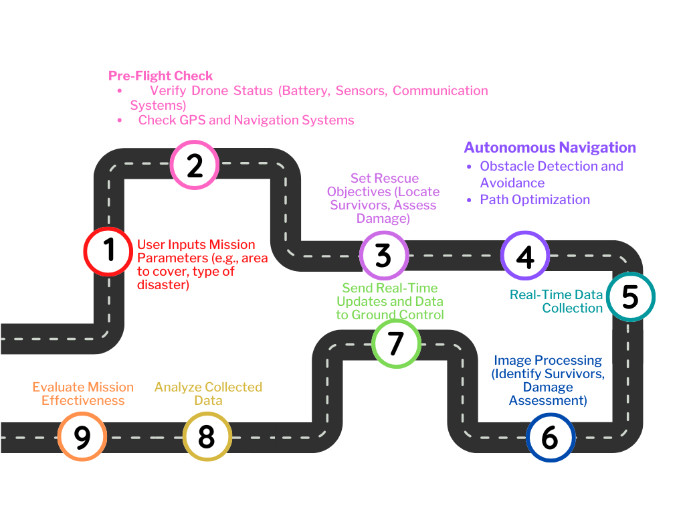



TECHNICAL APPROACH
HACTIVATORS
HARDWARE:
Thermal Sensors
GPR for underground operations
UAV
GPS Module
Microcontroller Unit ( Arduino, raspberry pi )
Power system
Data Storage Unit
Problem flow:
SOFTWARE:
Arduino IDE
Python OpenCV Module
MYSQL for data storage

Slide 5
FEASIBILITY AND VIABILITY
HACTIVATORS
Open-source platforms: Availability of open-source software and hardware platforms facilitates development and customization.
Speed and Accessibility: Drones quickly reach areas inaccessible to ground vehicles.
Interoperability: Modern software architectures support seamless integration with various hardware components.
Cost-Effectiveness: Drones are a more affordable alternative to traditional methods like helicopters.
Scalability: Software solutions can be easily scaled to accommodate different drone models and mission complexities.
Scalability and Flexibility: Drones can be rapidly deployed and scaled to cover large areas, making them ideal for disasters.
Cost-effectiveness: Software development often offers cost-effective solutions compared to hardware modifications.
Regulatory Hurdles: In some regions, airspace regulations may complicate the use of drones, especially near airports or urban areas.
Rapid deployment: Software updates and new features can be deployed quickly, improving response times.
Limited Battery Life: Drones have restricted flight times, which can impact their ability to continuously monitor large areas.
6

Slide 6
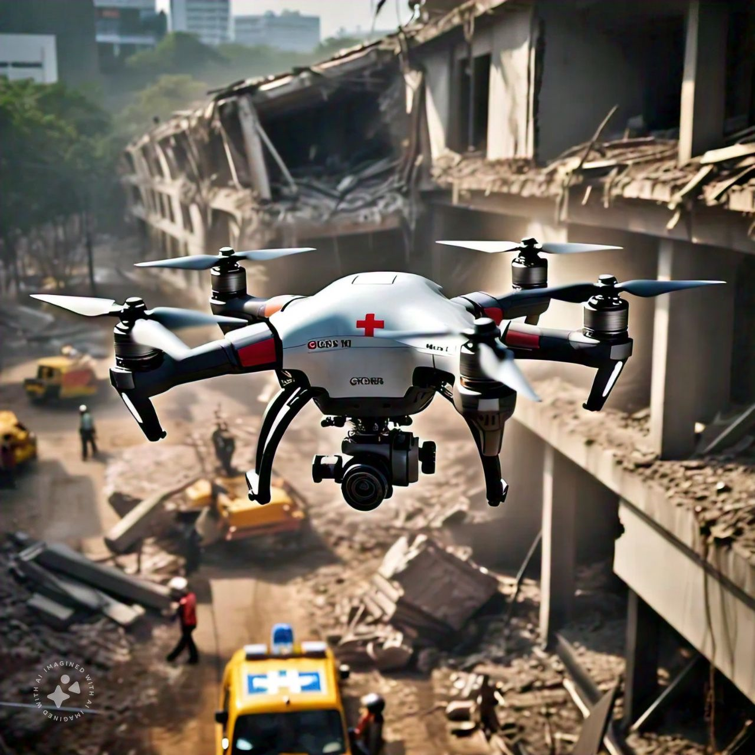
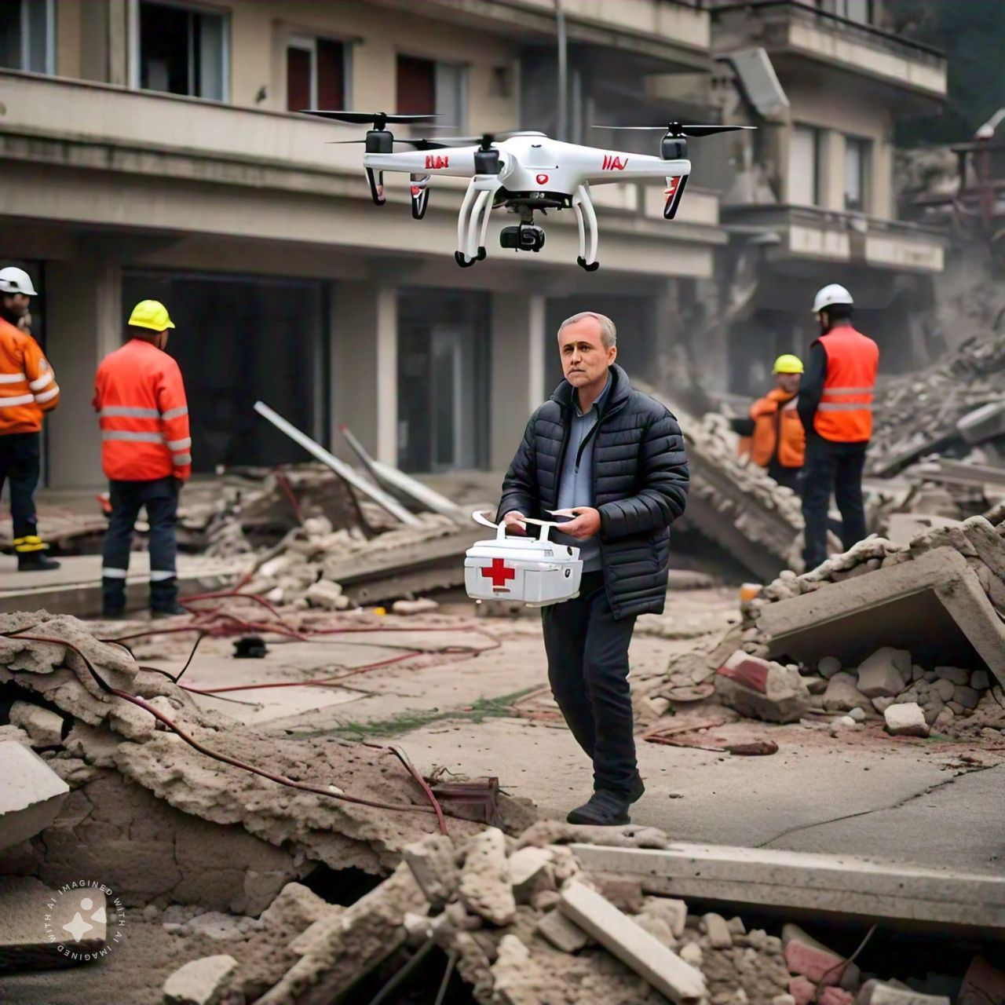
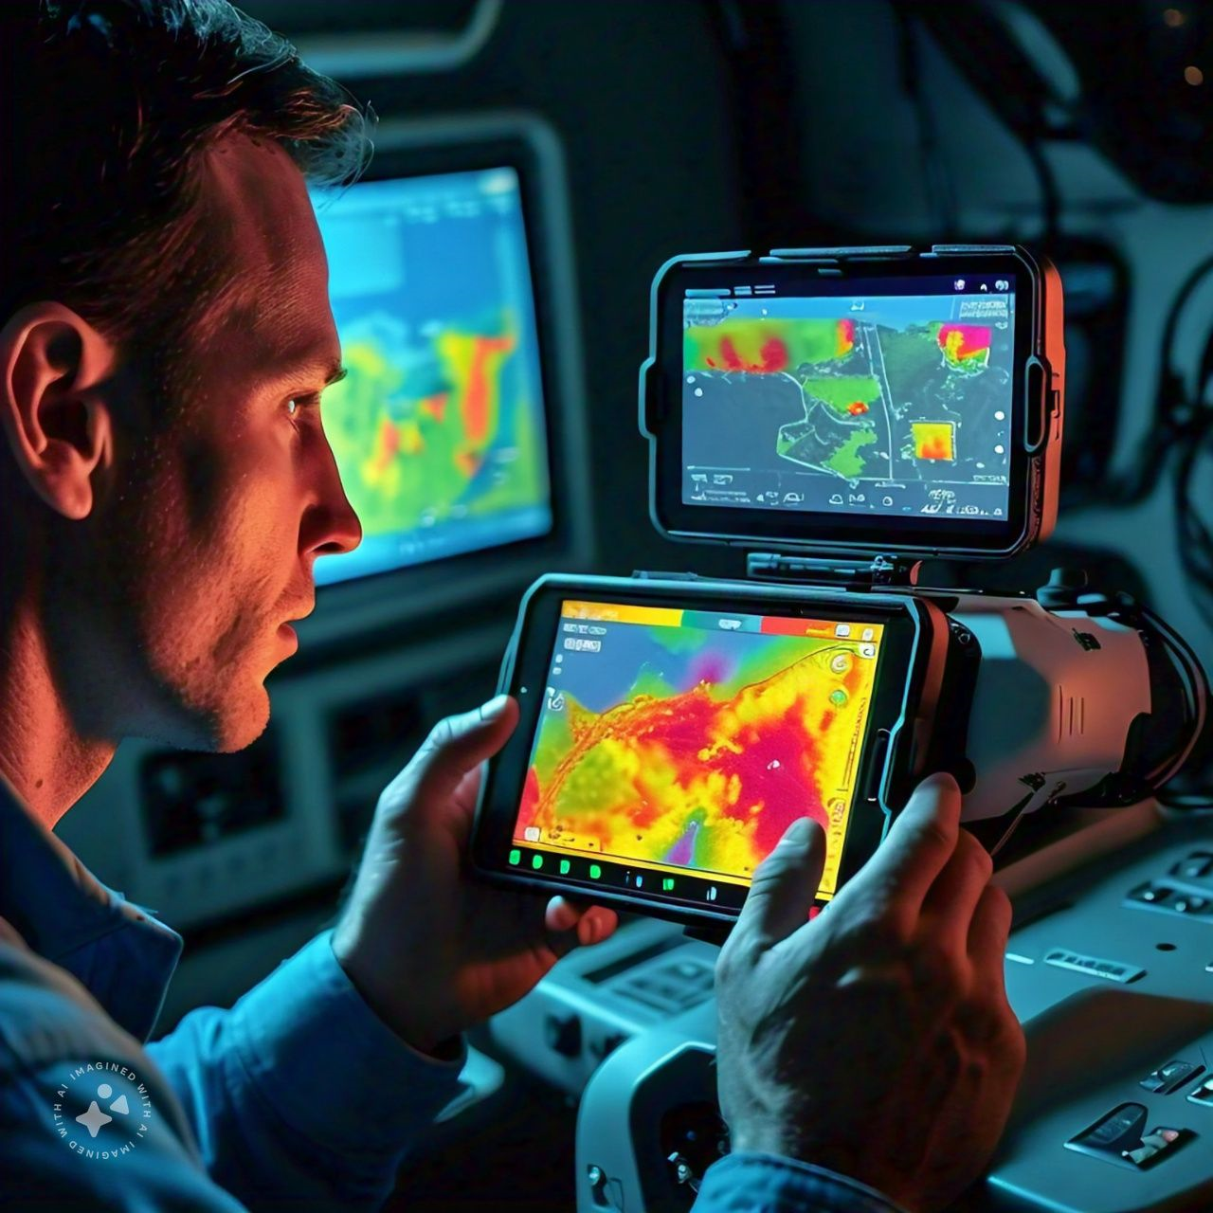
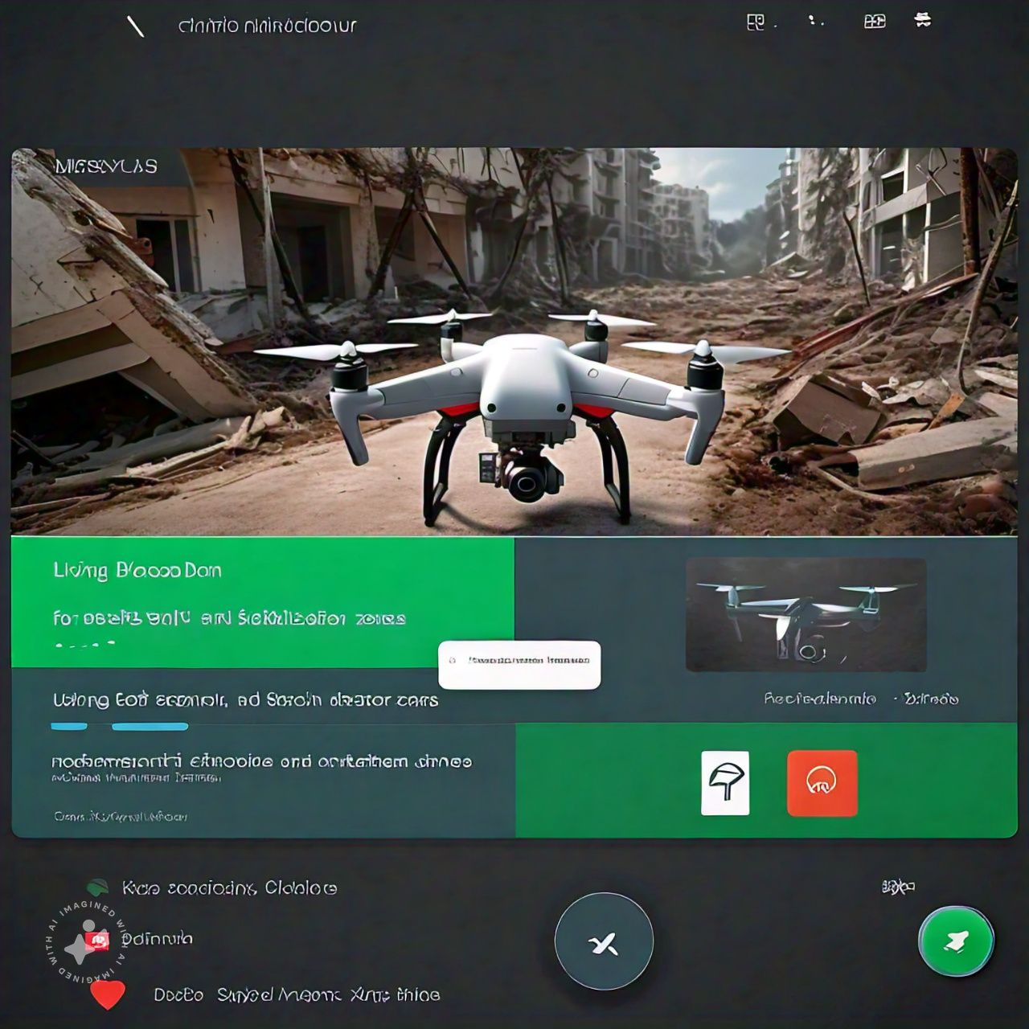
IMPACT AND BENEFITS
HACTIVATORS
Impact
Empowerment and Community Involvement: using this software drones can empower communities by involving them in disaster response. | A key advantage of using this software is upgrading the ability of drones to quickly survey large areas, unlike traditional methods that are labor-intensive and time-consuming.
Long-Term Social Impact: application of this software in disaster zones may change views on technology, increasing acceptance and investment in future innovations. | Real-Time Data: Live video and high-resolution images taken using this software offer immediate situational awareness, helping rescue teams prioritize and make informed decisions.
Data Sharing: using this software drones transmit data to multiple agencies, ensuring a shared understanding, reducing duplication, and improving resource allocation. | Efficient Use of Resources: Improved coordination minimizes waste and optimizes resource allocation, ensuring aid reaches those in greatest need.
Reassurance: Drones reassure survivors by showing that help is on the way and efforts are being made to assist them. | Protecting Rescuers: Drones reduce rescuers' exposure to danger, safeguarding their lives and maintaining team effectiveness and morale.
Encouraging Investment: Successful usage of this software use can attract funding for research, leading to more advanced disaster response tools. | Reduction of panic Deaths: Studies show panic can cause more deaths than the disaster. Using this software drones reassure people, boosting hope and reducing helplessness.
On site work:
Benefits
Predicted Software samples:

Slide 7
RESEARCH AND REFERENCES
HACTIVATORS
S Ahmed - Sukkur IBA Journal of Emerging Technologies, 2024
"Legal and Regulatory Frameworks for Drone Operations in Disaster Response" - International Journal of Disaster Risk Reduction
"A Decentralized Approach for UAV Swarm Coordination in Disaster Relief Operations" - IEEE Transactions on Aerospace and Electronic Systems
"Deep Learning for Object Detection and Classification in UAV Imagery for Disaster Response" - IEEE Geoscience and Remote Sensing Letters,.
"A UAV-Based System for Rapid Damage Assessment in Post-Disaster Scenarios" - IEEE Transactions on Geoscience and Remote Sensing,.
https://ieeexplore.ieee.org/document/6461145
https://www.sciencedirect.com/science/article/pii/S1355030621001477
https://enterprise-insights.dji.com/blog/search-and-rescue-drones

